Slide 1
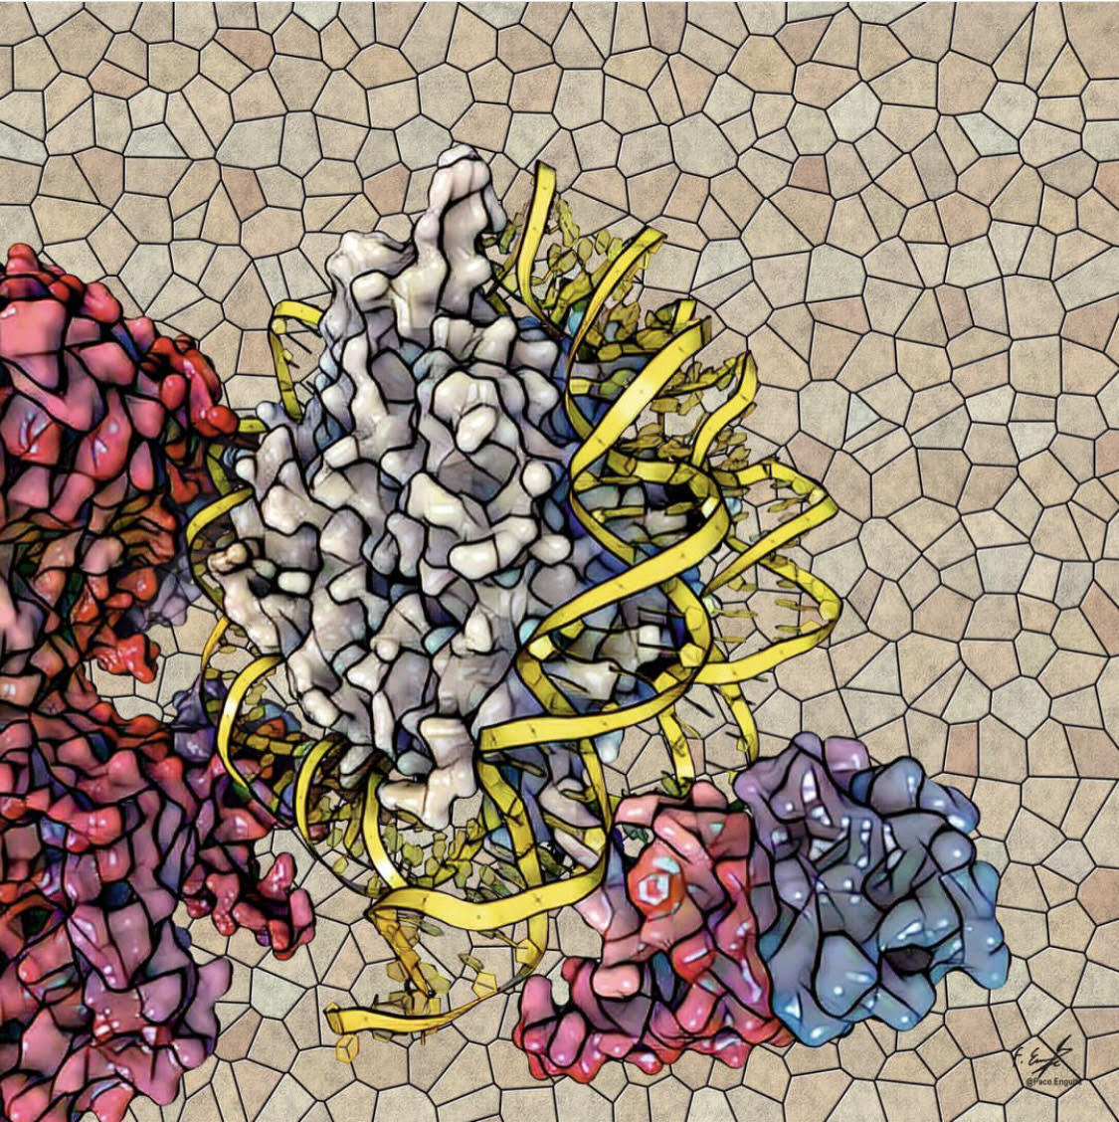
Introduction to Protein Databases: Part1
Fereshteh Noroozi
Fall 2023

Slide 2
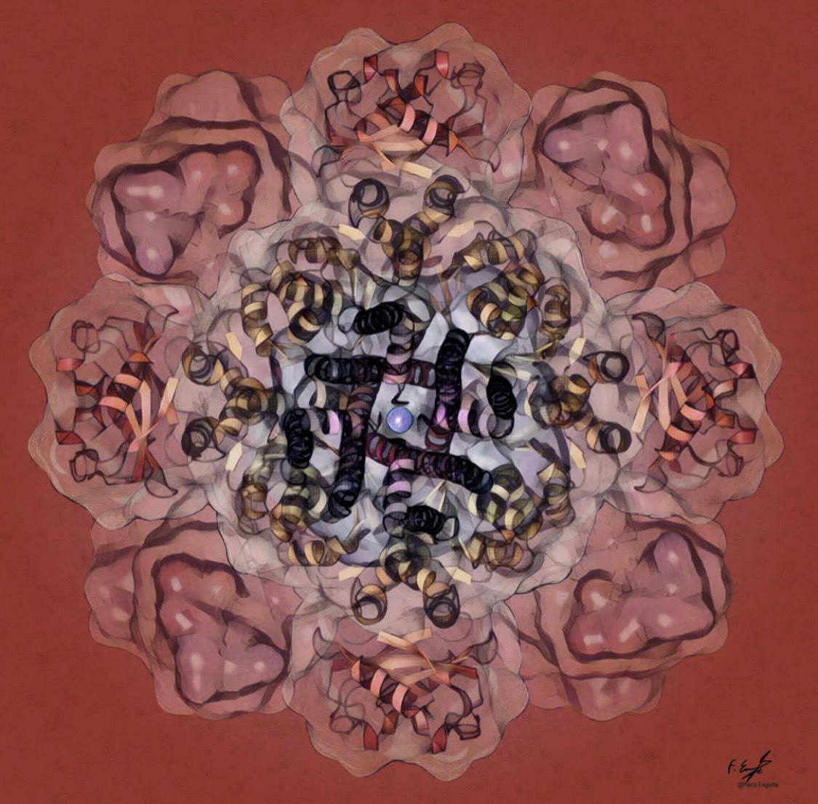
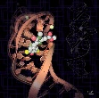
Importance of protein databases in research
Large-scale protein information
Accelerating research
Functional annotation
Structure prediction and modeling
Comparative analysis
Data-driven discoveries
Bioinformatics tools and resources
1

Slide 3
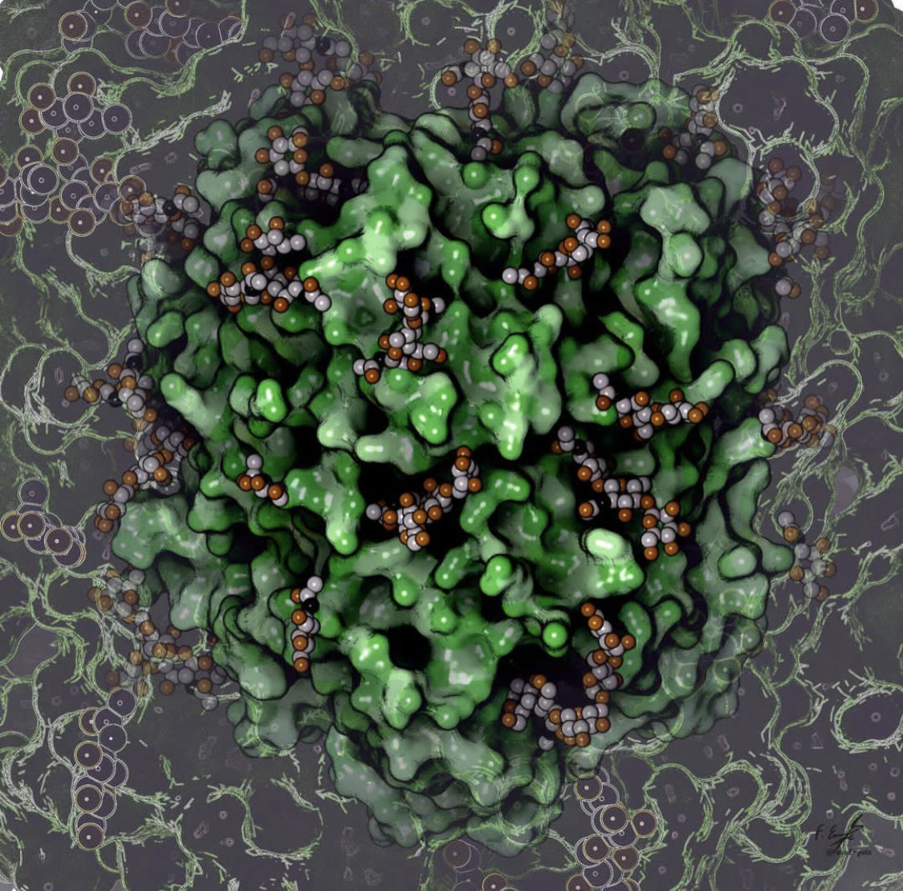
Key resources
TmAlphaFold
BioGRID
HIPPIE
dcGO
MatrisomeDB
DEPICTER2
DescribePROT
2

Slide 4
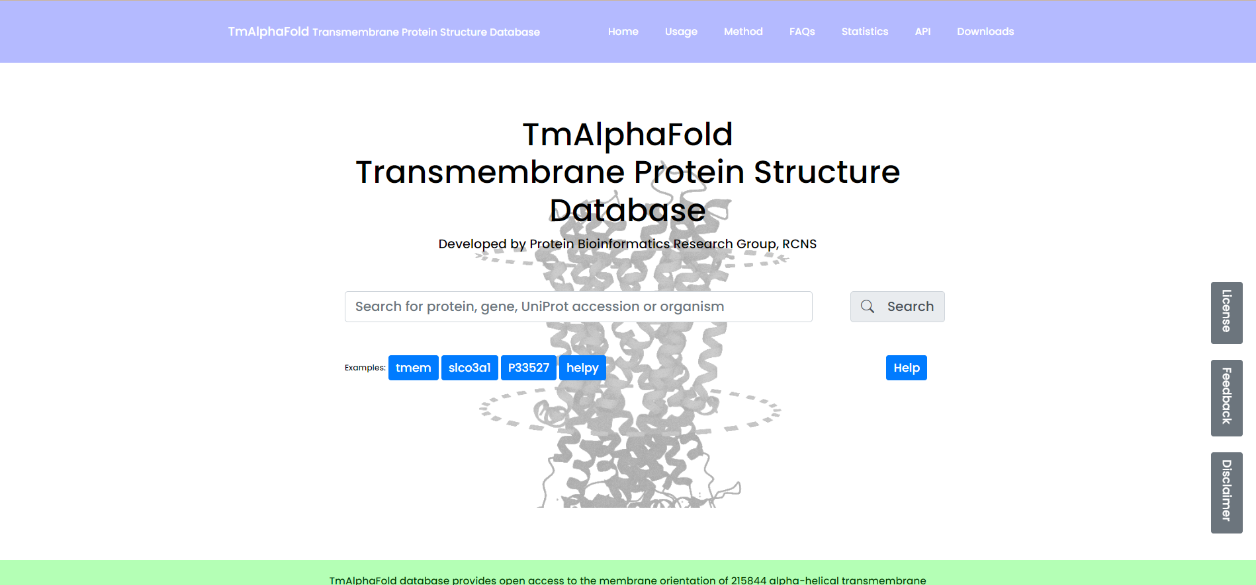
TmAlphaFold
3

Slide 5
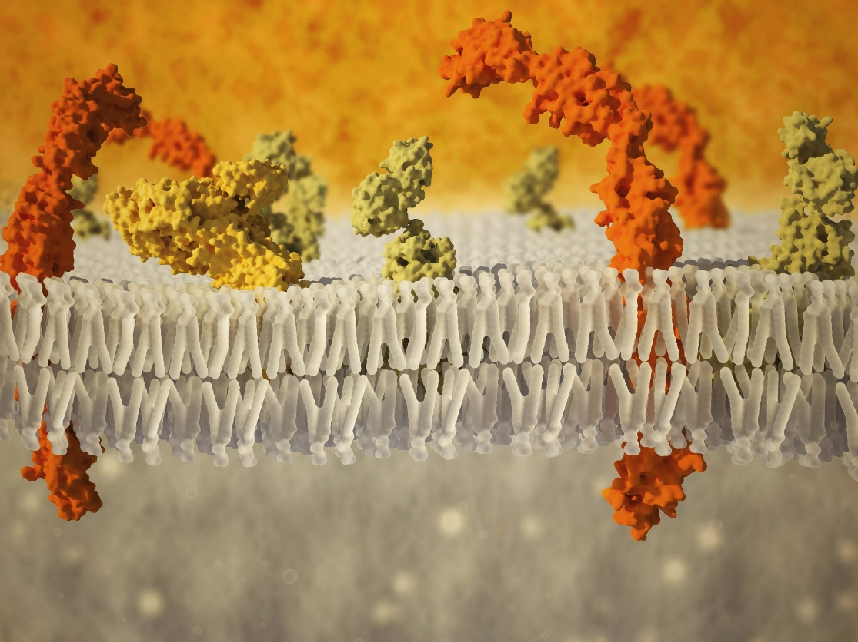
TmAlphaFold
Transmembrane proteins
Cell membrane
Molecular transport
Signal transmission
Structural integrity
Lipid bilayer
Cellular processes
4

Slide 6
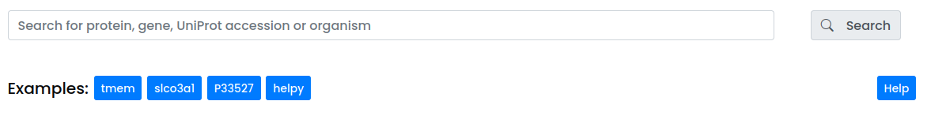
TmAlphaFold
Search modes:
Gene name
UniProt Accession
UniProt ID
Species
5

Slide 7
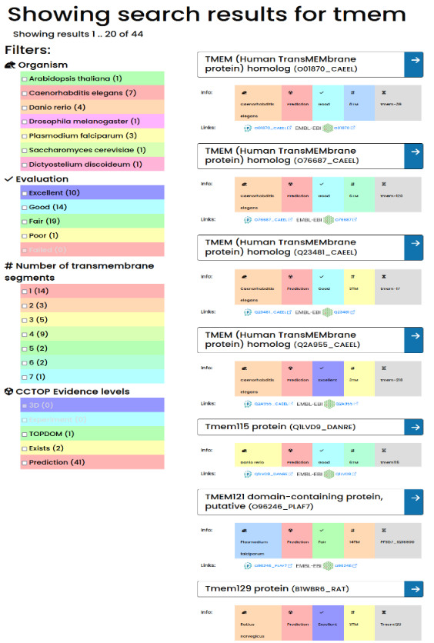
TmAlphaFold
Search results:
Protein name
Gene name
Organism
UniProt AC (UniProt Accession)
AlphaFold Database hyperlink
PDB-EBI hyperlink
Filter options (organism, quality of the structure, topology prediction evidence, number of transmembrane helices)
Navigation bar (on the left side) for further filtering and navigation
6

Slide 8
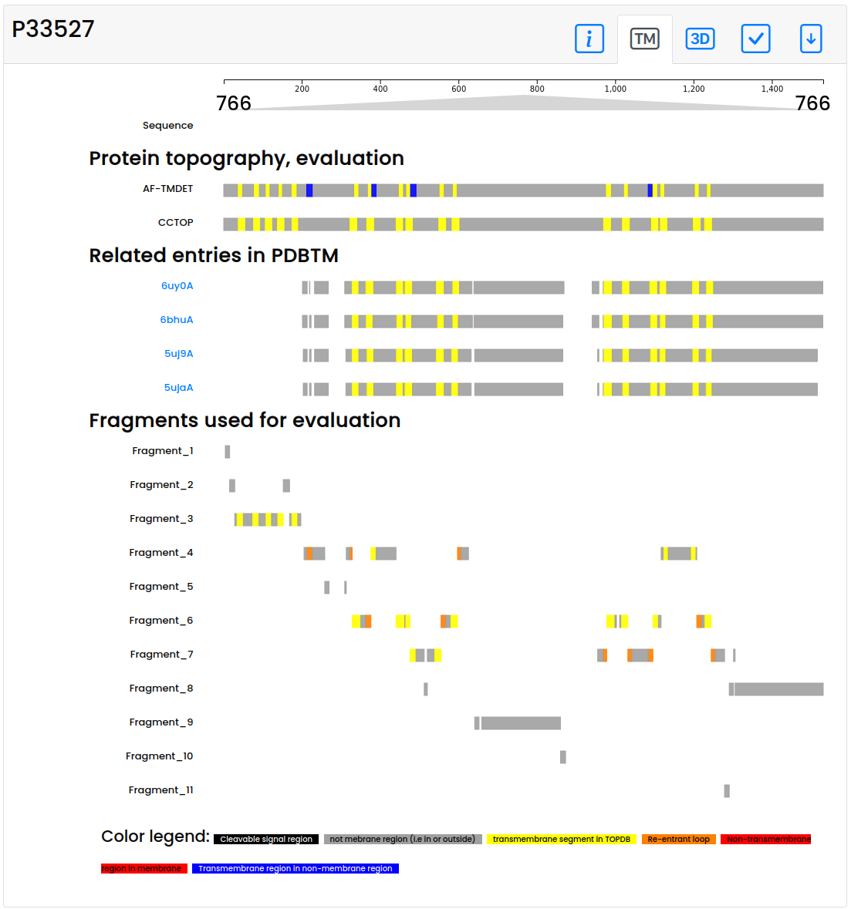
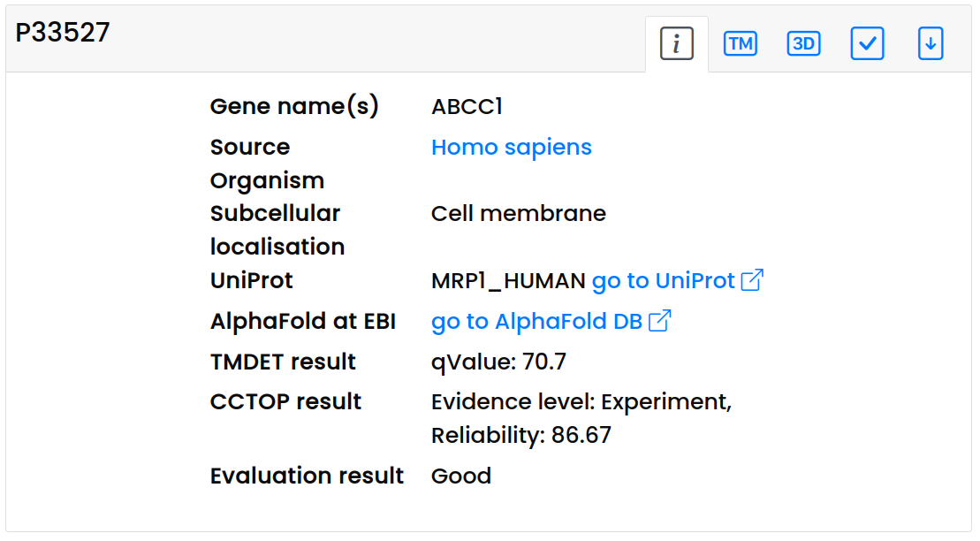
TmAlphaFold
Protein page:
Information panel
Topology panel
7

Slide 9
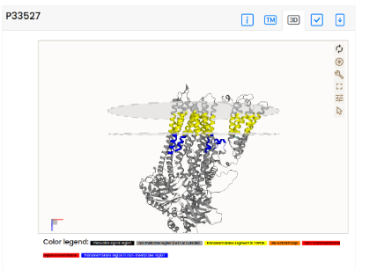
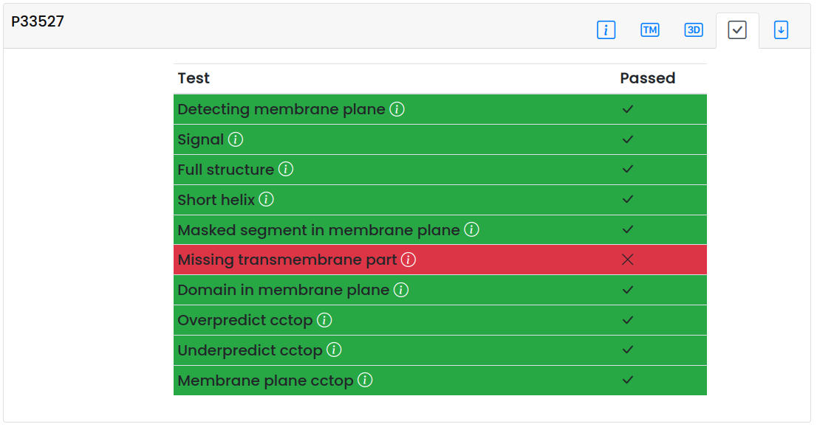
TmAlphaFold
Protein page:
3D structure panel
Evaluation panel
8

Slide 10
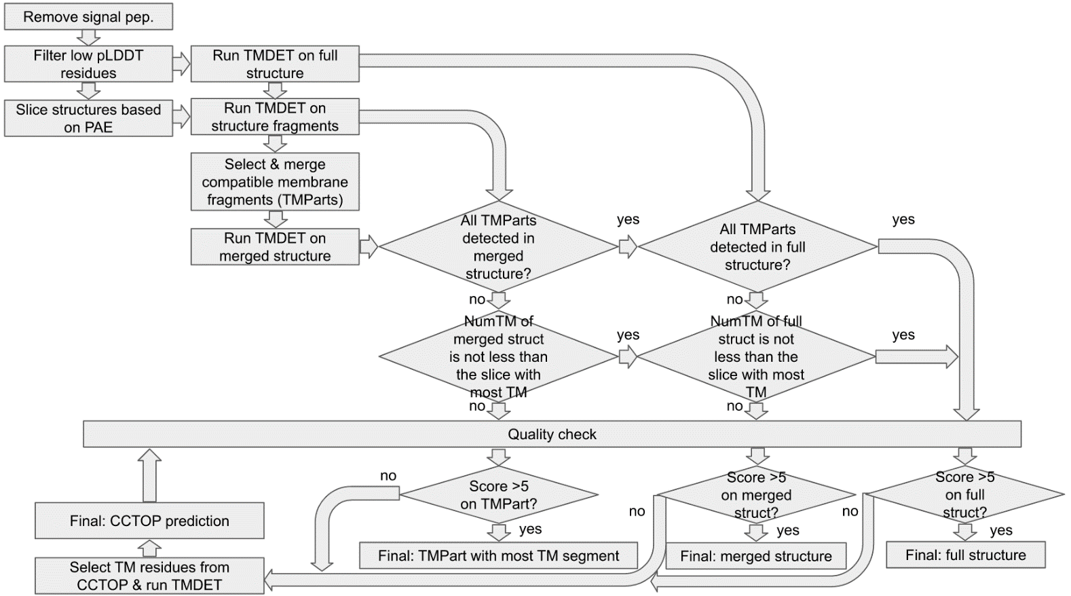
TmAlphaFold
Method
9

Slide 11
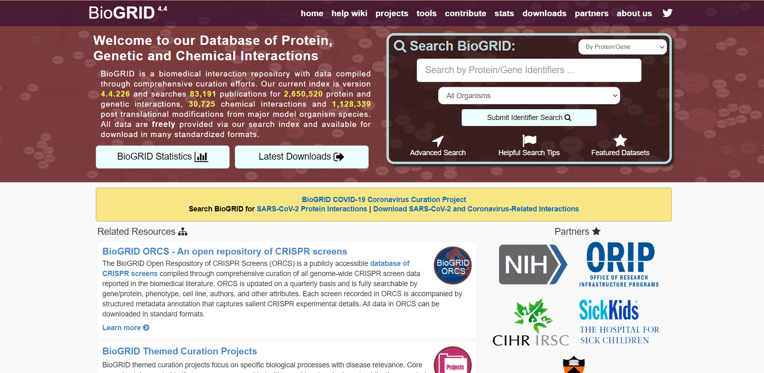
BioGRID
10

Slide 12
BioGRID
The Biological General Repository for Interaction Datasets (BioGRID):
Overview:
An open-access database.
Houses genetic and protein interactions.
Curated from primary biomedical literature.
Encompasses major model organism species and humans.
Statistics as of October 18, 2020:
Interactions: 1,928 million.
Publications: 63,083.
Model Organisms: 71.
Growth by January 2021:
Biological Interactions: >2,0 million.
Chemical-Protein Interactions: 29,023.
Post-Translational Modifications: 506,485.
Publications: 75,988.
Species: >80.
11

Slide 13
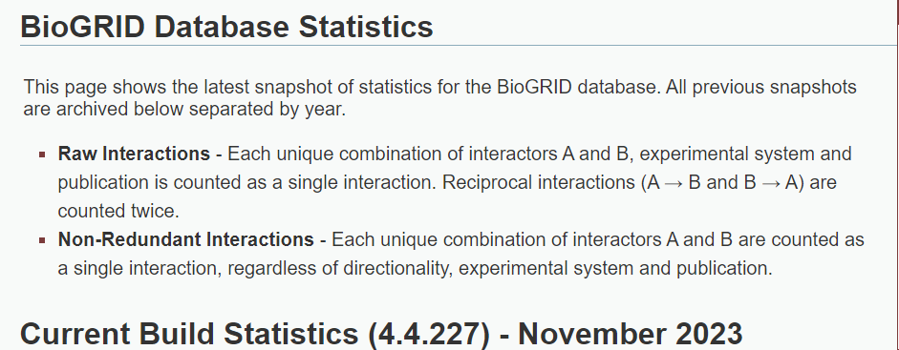
BioGRID
12

Slide 14
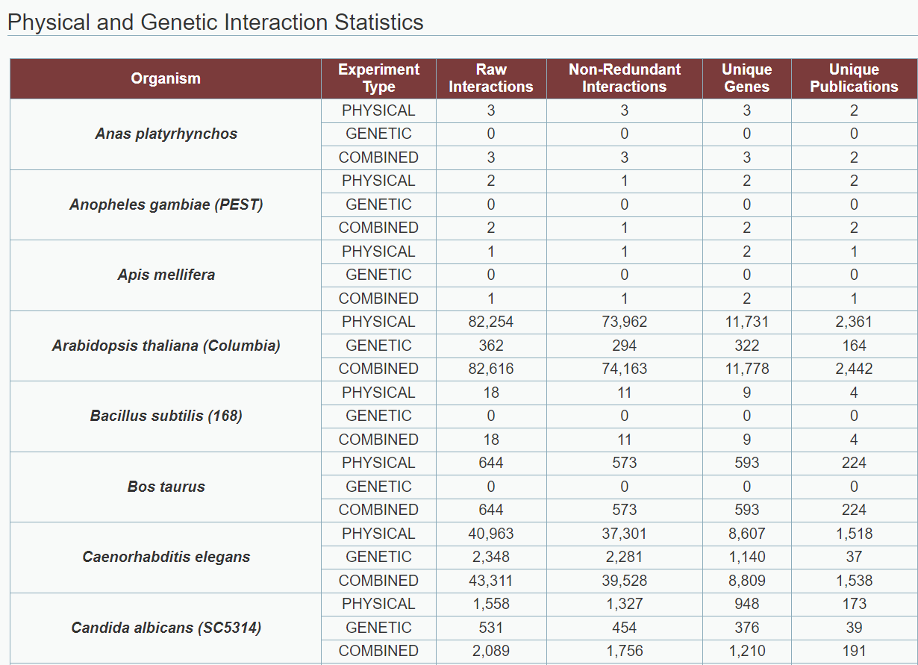
BioGRID
13

Slide 15
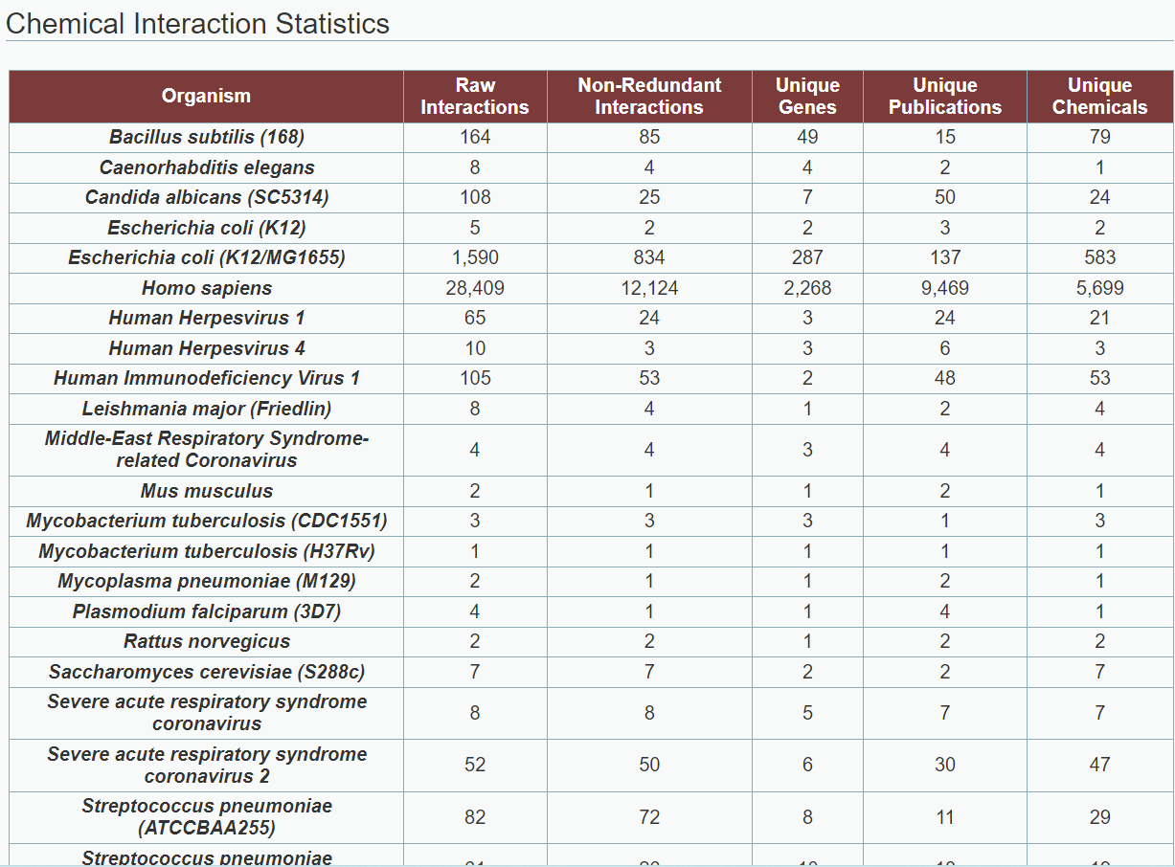
BioGRID
14

Slide 16
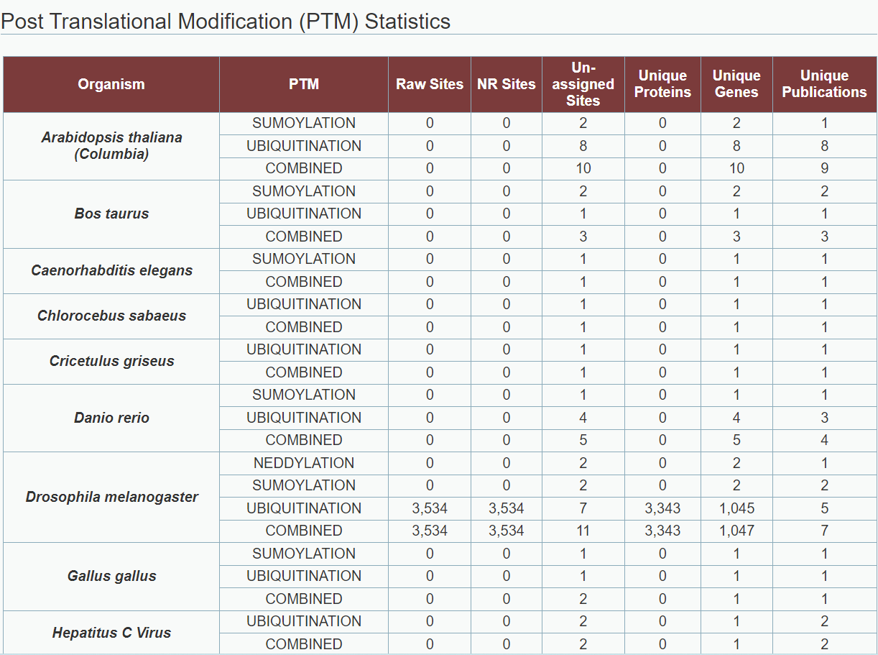
BioGRID
15

Slide 17
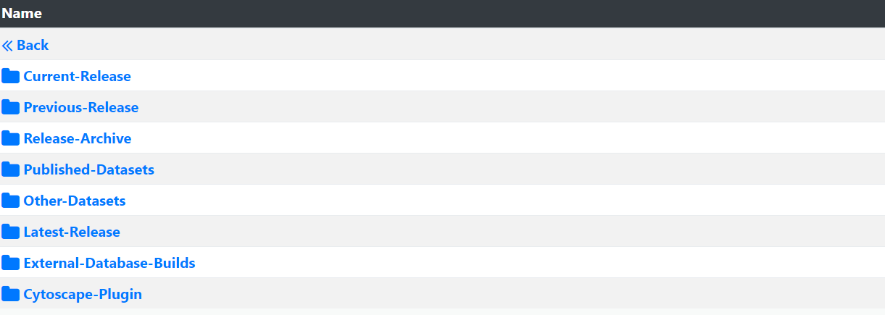
BioGRID
Download
16

Slide 18
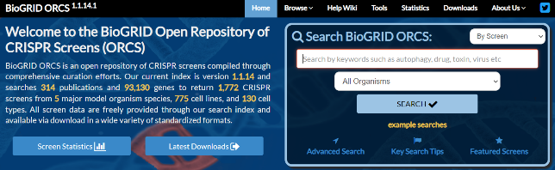
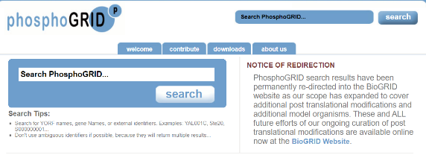
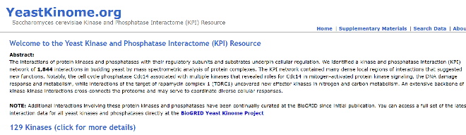
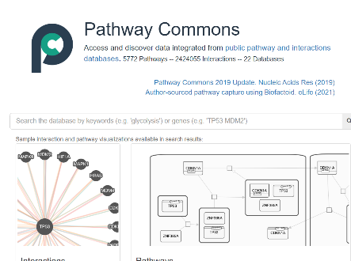
BioGRID
Online Tools and Resources
BioGRID ORCS - The BioGRID Open Repository of CRISPR Screens (ORCS)
PhosphoGRID
Yeast Kinome - Saccharomyces cerevisiae Kinase and Phosphatase Interactome (KPI) Resource
Pathway Commons
17

Slide 19
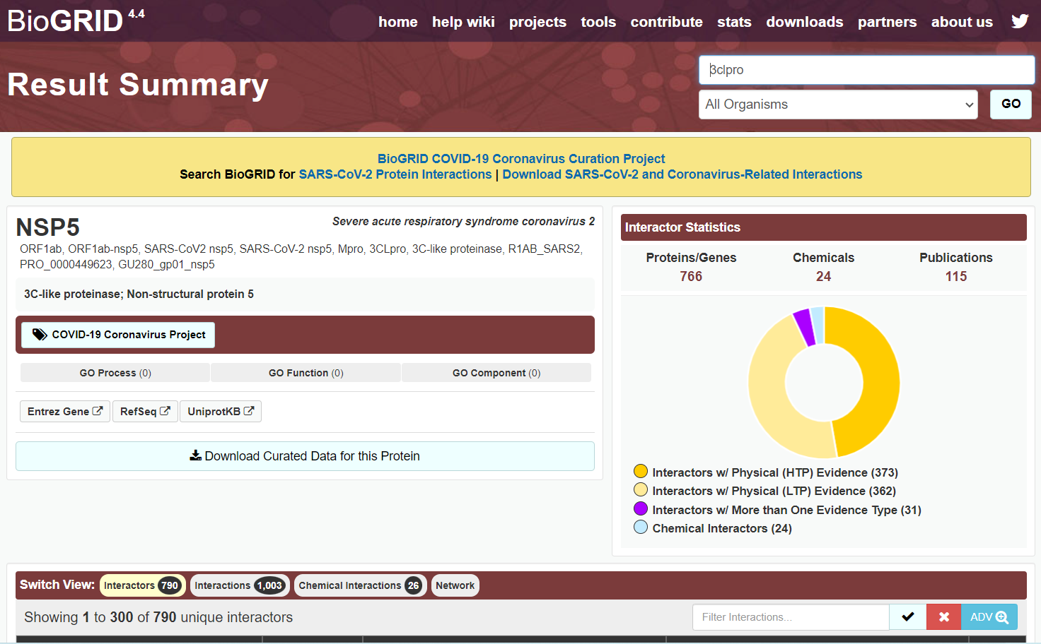
BioGRID
Example
18

Slide 20
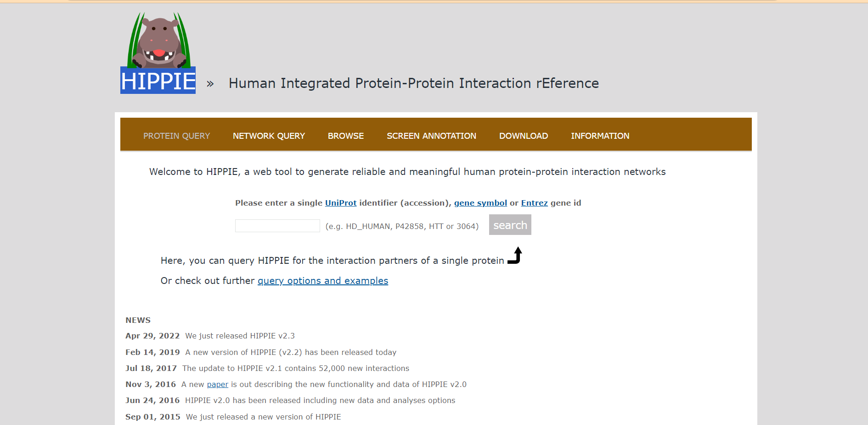
HIPPIE
19

Slide 21
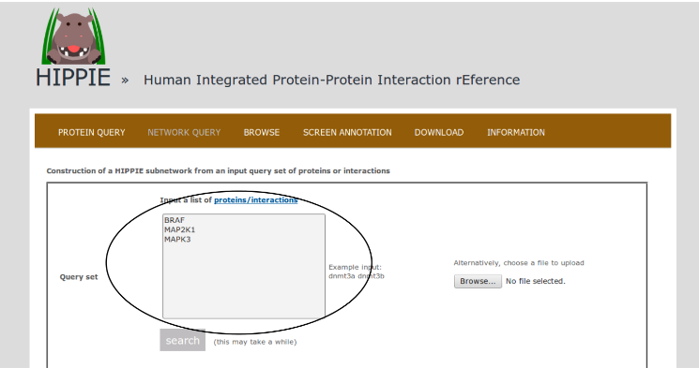
HIPPIE
BRAF, MEK1 (MAP2K1) and ERK1 (MAPK3), which are members of the Mitogen-activated protein kinase (MAPK) signaling cascade and activate each other in the stated order.
20

Slide 22
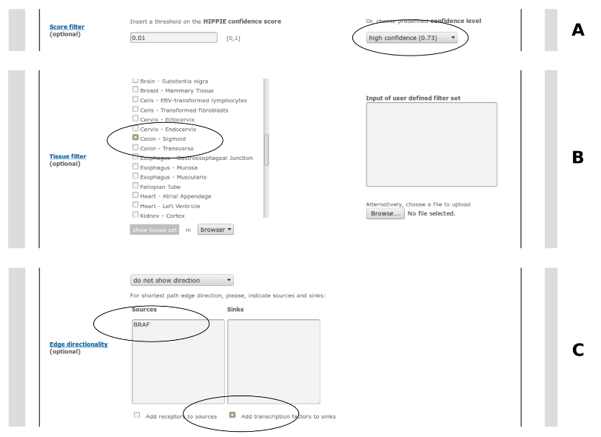
HIPPIE
Filter (A): High Confidence Interactions
Filter (B): Colon Tissue Specificity
Contextual Information
BRAF Mutation Analysis
Filter (C): Shortest Path to Transcription Factors from BRAF
Final Interaction Set
21

Slide 23
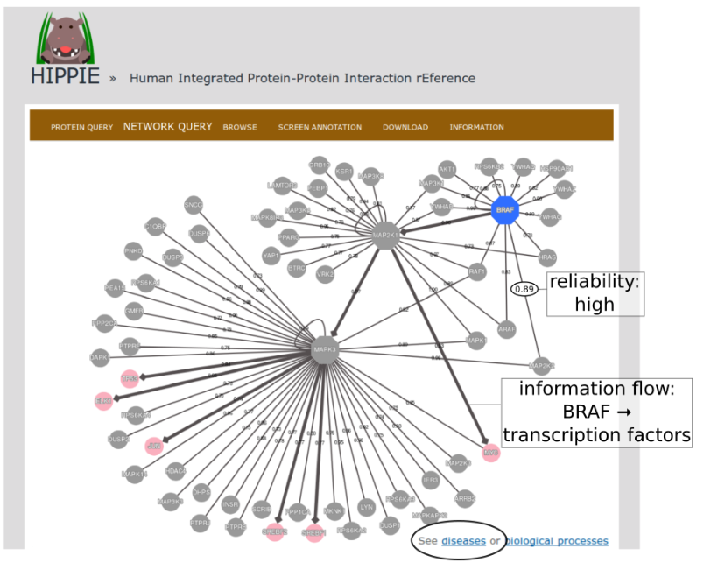
HIPPIE
Shortest Paths from BRAF to Transcription Factors
Terminal Nodes (Transcription Factors)
Further Analysis Option - Disease Identification
Tool Utilized
Interactive Exploration
22

Slide 24
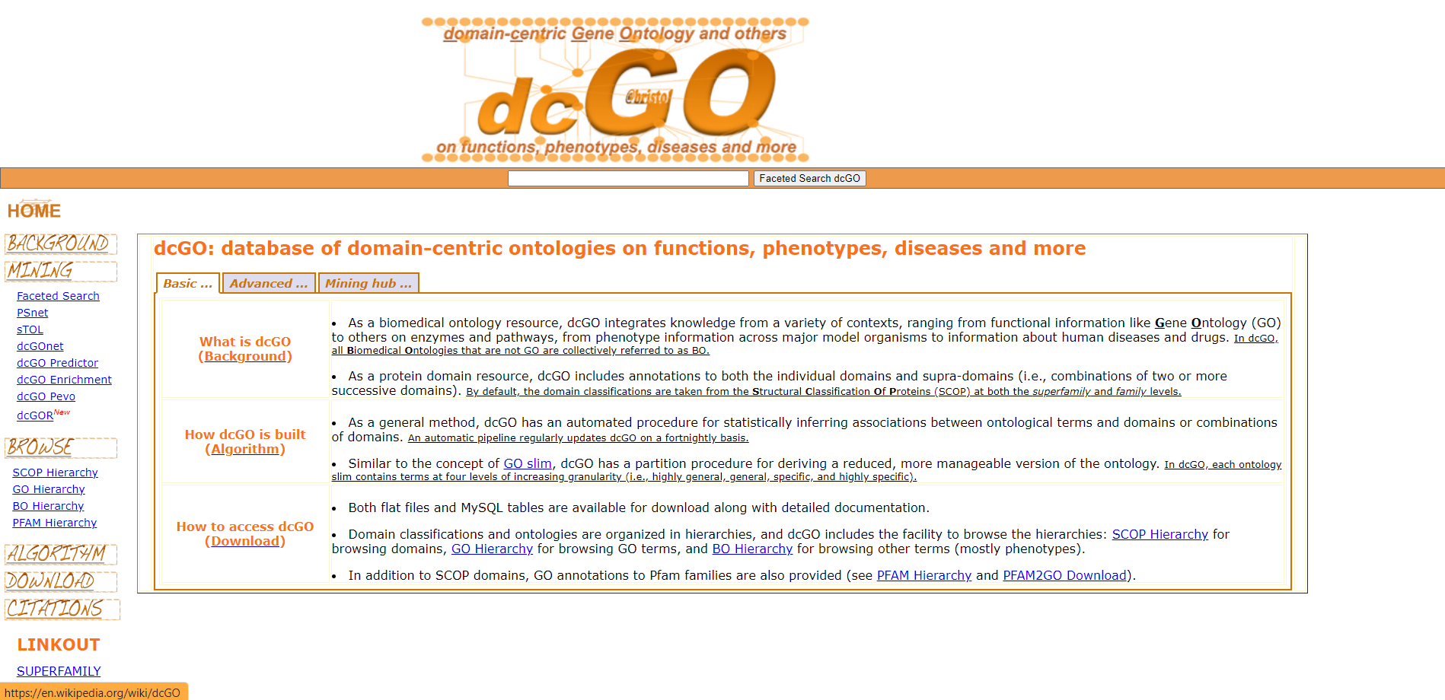
dcGO
23

Slide 25
dcGO
Modular Design of Proteins:
Proteins exhibit a modular design.
Contribution of Protein Domains:
Protein domains play a crucial role in understanding proteomic data.
Their contributions can be structural, evolutionary, and functional.
Ontological Terms and Protein Domains:
Instead of associating ontological terms solely with full-length proteins, it is beneficial to associate terms with protein domains.
Operational Units and Functional Responsibility:
More than one domain can function as the operational unit responsible for a particular function.
This can occur through collaboration or interaction at the interface between domains.
Associating Terms with Domain Combinations:
It is useful to associate ontological terms not only with individual domains but also with pairs of domains, triplets, and longer supra-domains.
Developed Method for Detection:
A general method has been developed to detect functional and phenotypic signals.
This method is based on gene/protein-level annotations and can be explained at the protein domain (and their combinations) levels
24

Slide 26
dcGO
Source of Domain Classifications
Focus Levels
Criteria for Superfamily Level
Detection and Classification in SUPERFAMILY
Representation of Proteins
Hierarchy within Superfamilies
Co-occurrence and Co-evolution
Supra-domains Definition
Domain Architecture Representation
Exclusion of Gaps in Supra-domains
25

Slide 27
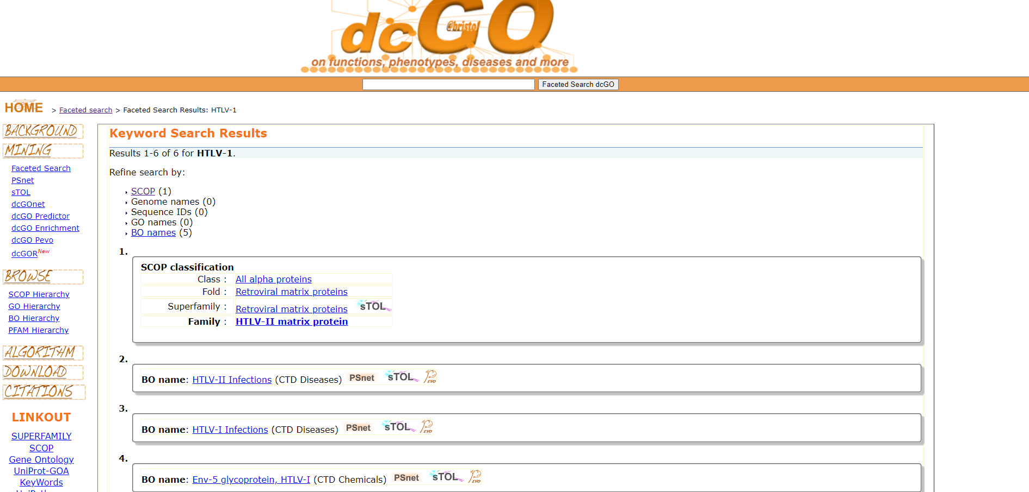
dcGO
Example
26

Slide 28
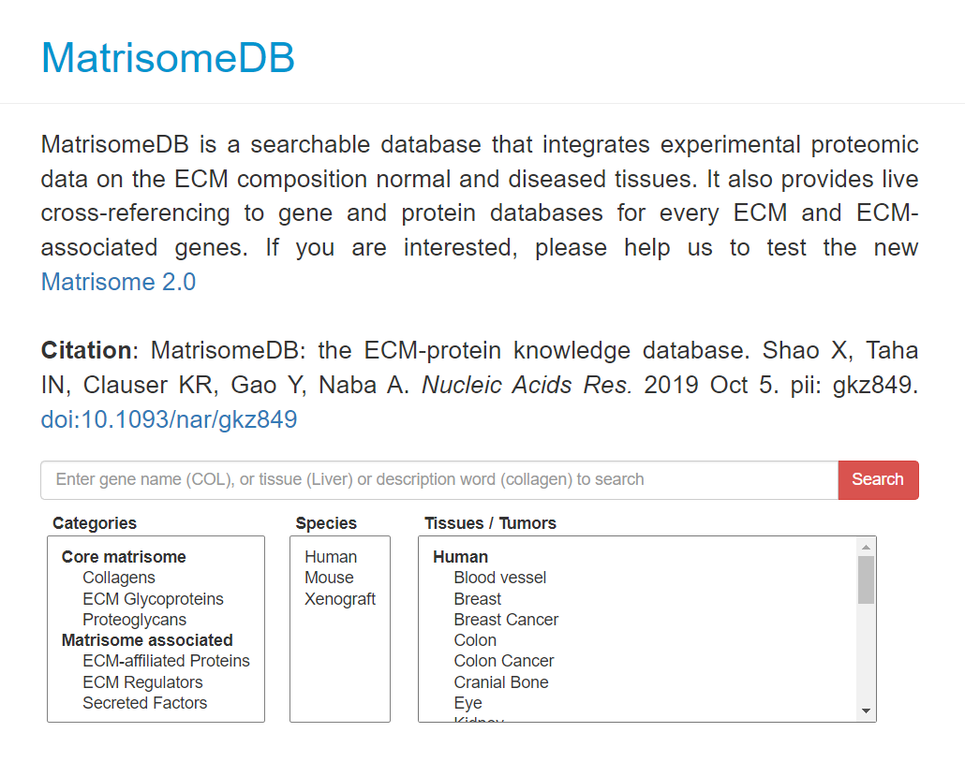
MatrisomeDB
27

Slide 29
MatrisomeDB
Database Overview:
MatrisomeDB is a searchable database integrating experimental proteomic data on extracellular matrix (ECM) composition in normal and diseased tissues.
Entry Details:
Each entry provides information on the tissues where it was detected.
Coverage Map
A coverage map illustrates detected peptides for each entry.
Post-Translational Modifications:
Cross-Referencing
2019 Release Collaboration
2022 Release (MatrisomeDB 2.0) Features
28

Slide 30
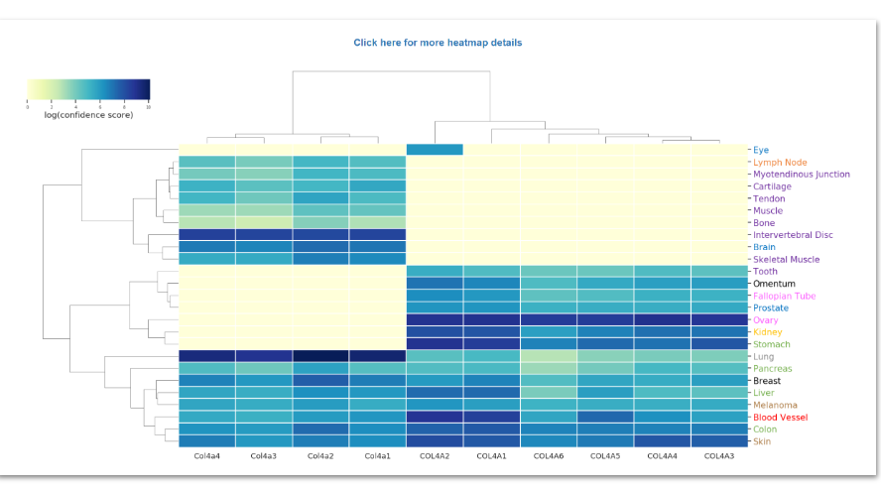
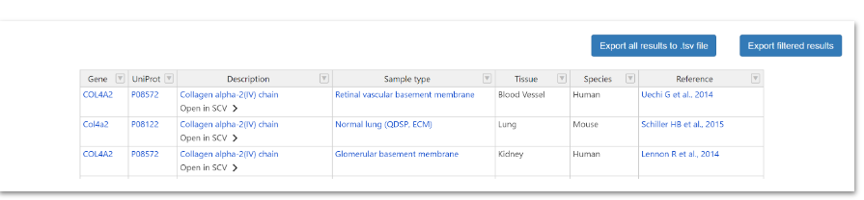
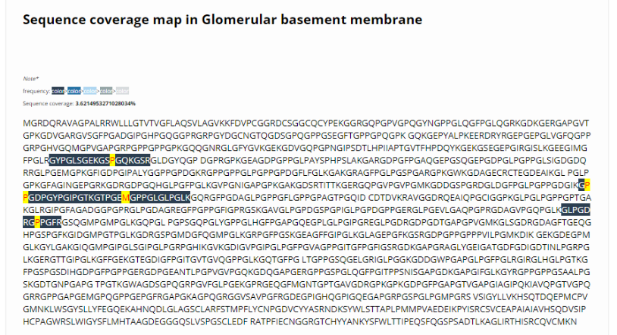
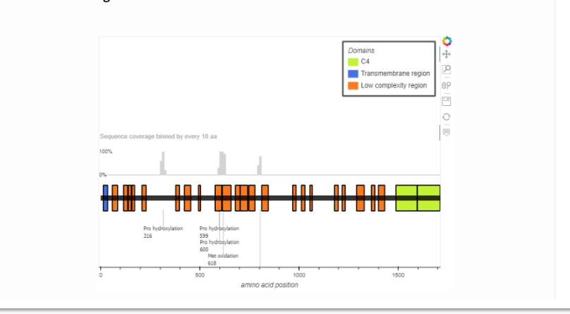
MatrisomeDB
Result
29

Slide 31
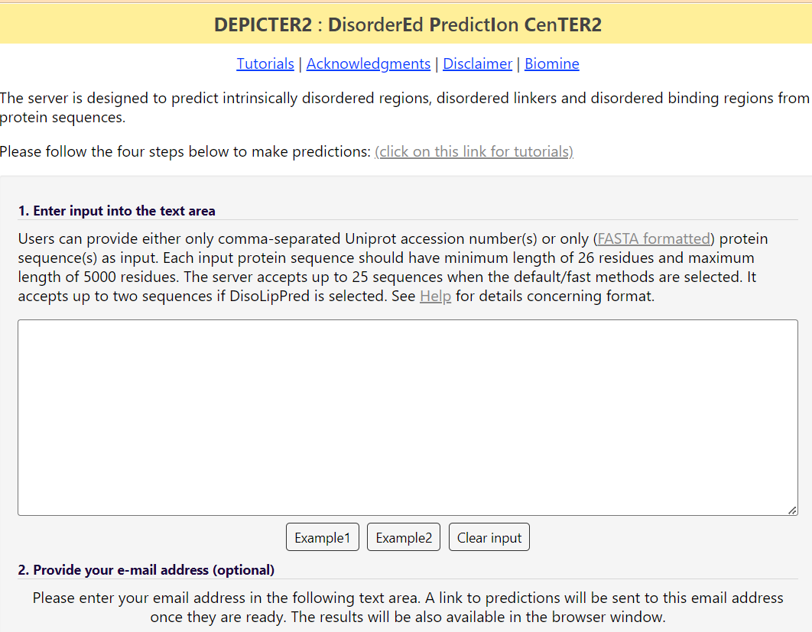
DEPICTER2
30

Slide 32
DEPICTER2
Server Type: Computational platform or online tool.
Prediction Target 1: Intrinsically disordered regions in protein sequences.
Prediction Target 2: Disordered linkers connecting structured domains.
Prediction Target 3: Disordered binding regions involved in interactions.
Purpose: Analyzing protein sequences for intrinsic disorder-related features.
31

Slide 33
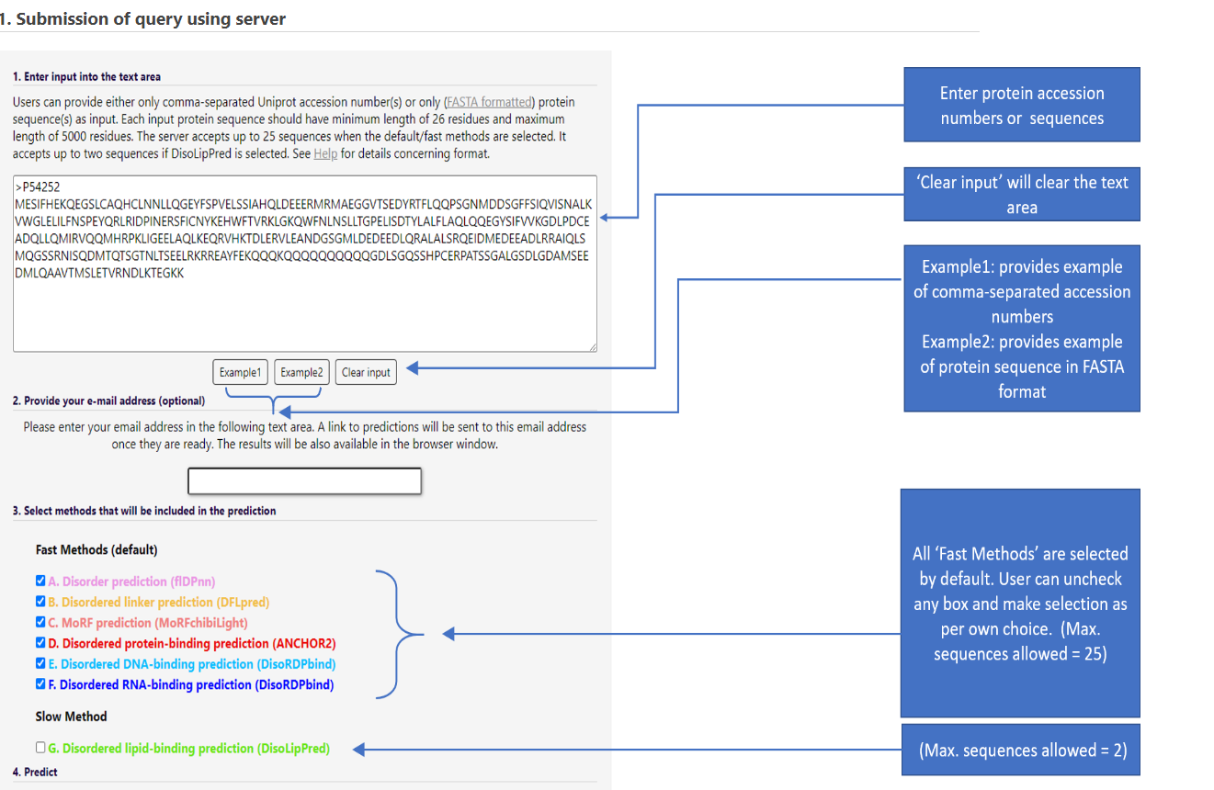
DEPICTER2
32

Slide 34
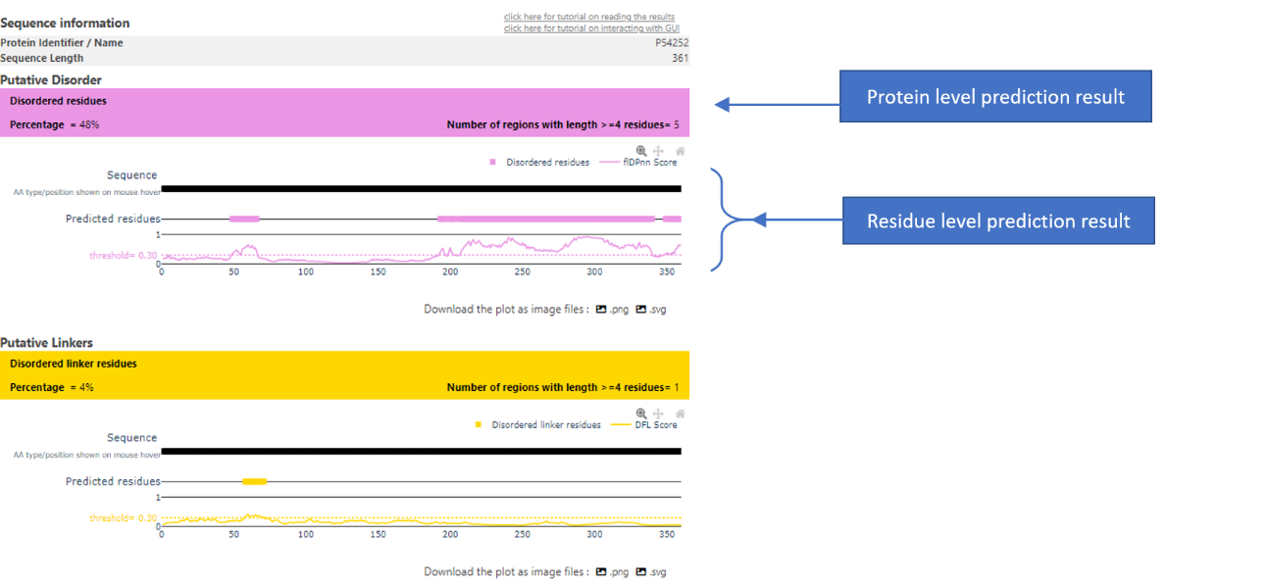
DEPICTER2
33

Slide 35
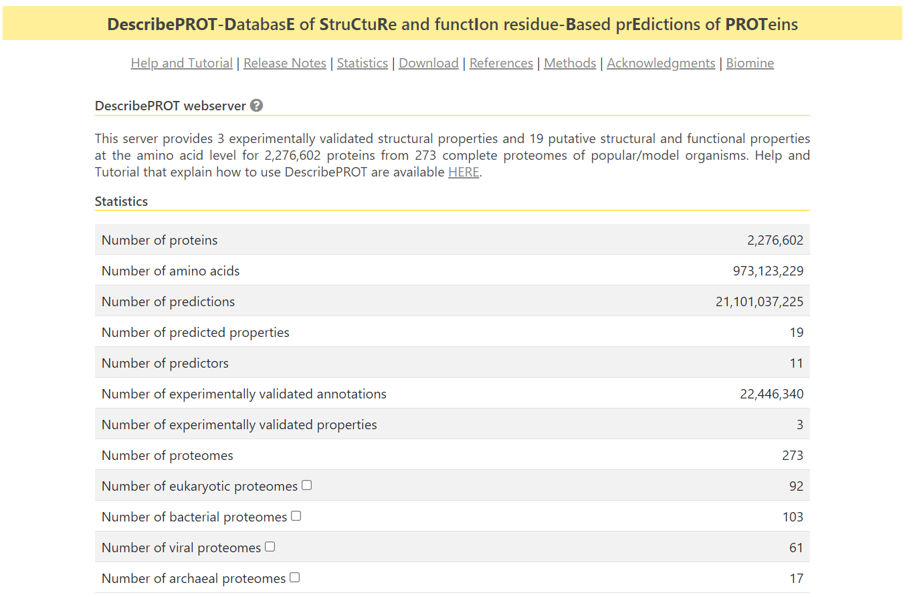
DescribePROT
34

Slide 36
DescribePROT
Database Focus: Predicted amino acid-level descriptors of structure and function of proteins
Sequence Conservation
Position-Specific Scoring Matrix (PSSM)
Secondary Structure: 84.2%
Solvent Accessibility: Pearson’s Correlation Coefficient (PCC)
Intrinsic Disorder: AUC = 0.81
Disordered Linkers: Characteristic Curve (AUC), securing AUC = 0.72
Signal Peptides: Matthew’s Correlation Coefficient (MCC), showing high predictive quality (MCC ranges between 0.890 and 0.981)
MoRFs (Molecular Recognition Features): AUC of 0.87
Interactions with Proteins: AUCs between 0.64 and 0.72
Interactions with DNA: AUC = 0.78
Interactions with RNAs: AUC = 0.68
35

Slide 37
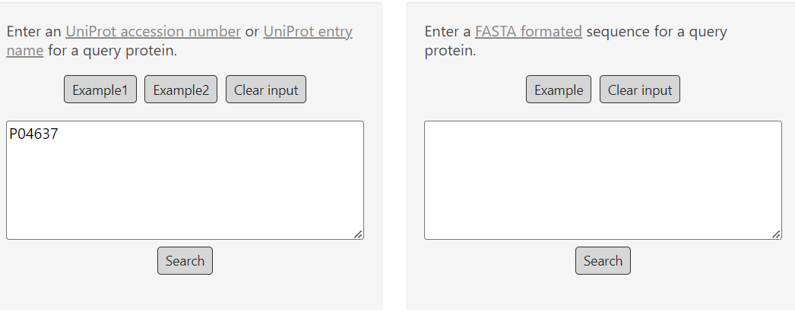
DescribePROT
36

Slide 38
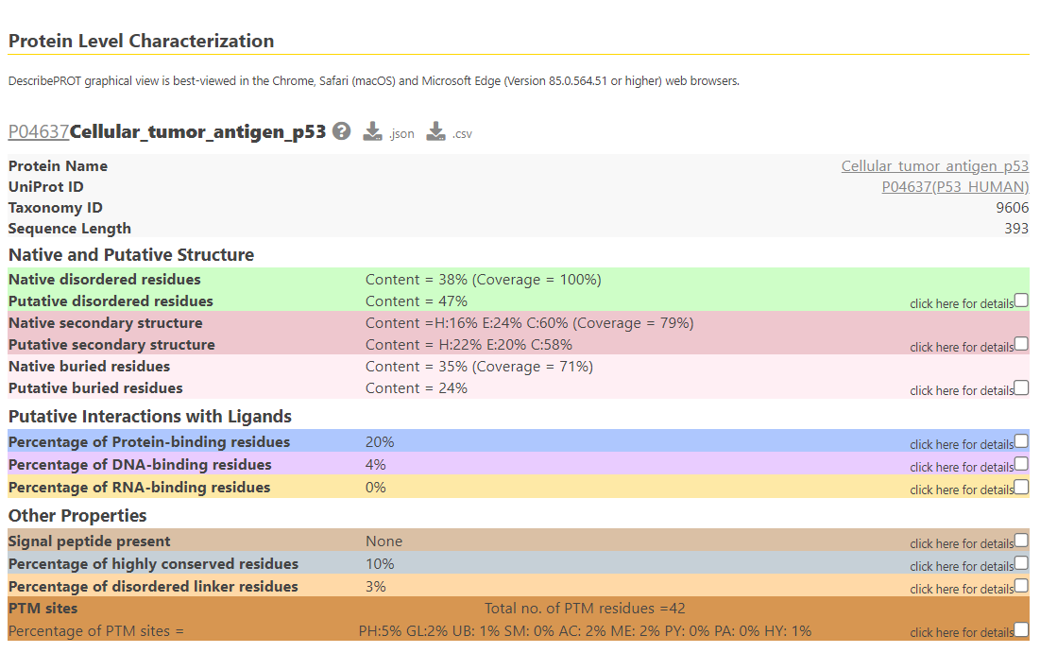
DescribePROT
37

Slide 39
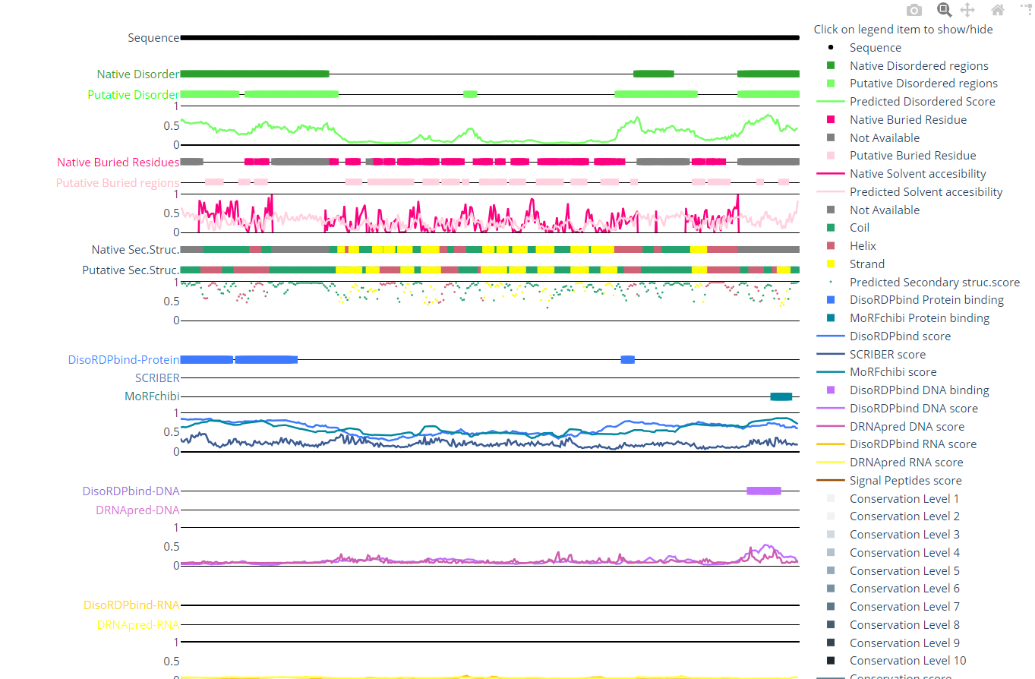
DescribePROT
38

Slide 40
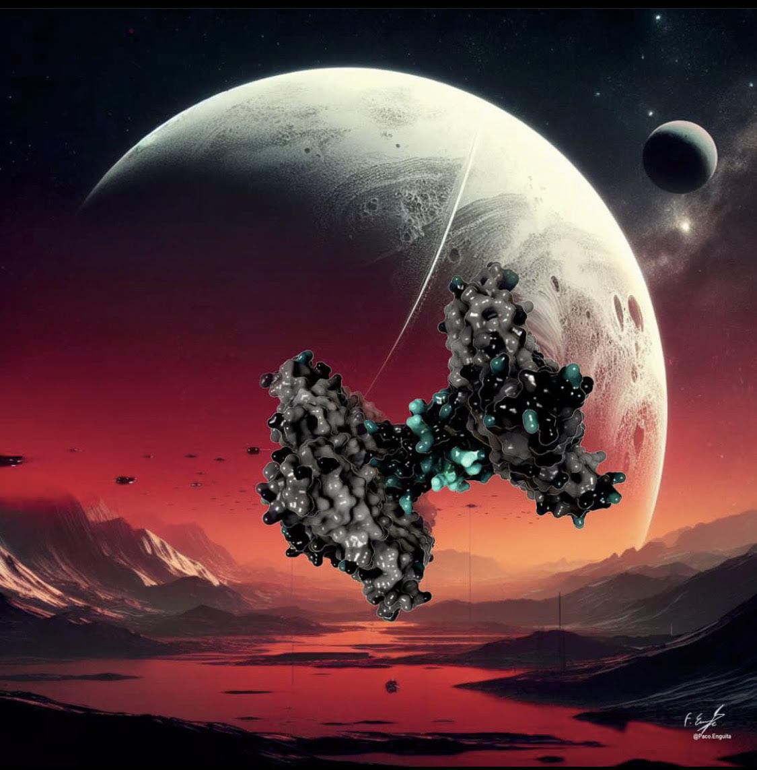
Gratitude to Prof. Francisco J. Enguita at Lisbon Medical School, University of Lisbon, Portugal, for generously granting permission to use his protein images.

